Slide 1
CSS & MEDIA QUERIES
AABISHKAR KARKI
SURAKSHYA BHANDARI

Slide 2
What is CSS ?
CSS “Cascading Style Sheets”
Cascading:
procedure that determines which style will apply to a certain section
Style: how you want a certain part of your page to look.
Sheets: the “sheets” are like templates, or a set of rules, for determining how the webpage
will look.
CSS is a stylesheet language used to define styles for your web pages, including the design, layout and variations in display for different devices and screen sizes.

Slide 3
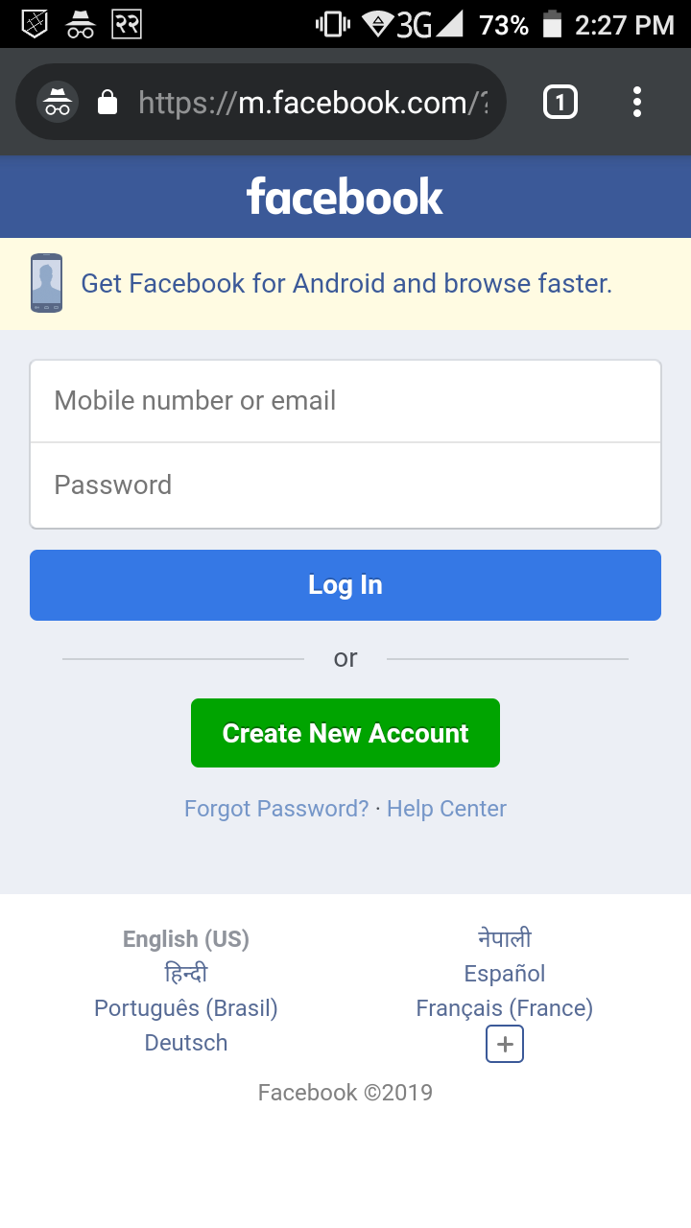
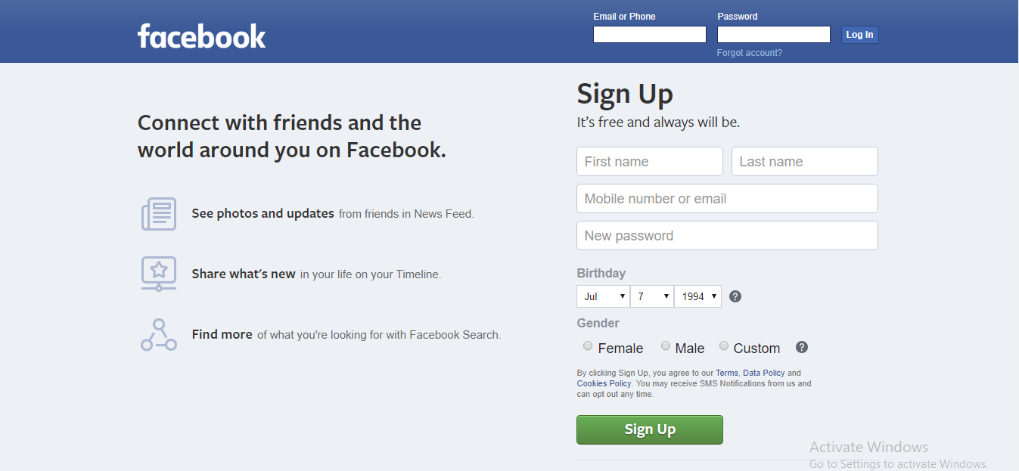
WEB VIEW
MOBILE VIEW

Slide 4
Why Use CSS?
HTML was NEVER intended to contain tags for formatting a web page!
HTML describe the content of a web page, like:
<h1>This is a heading</h1>
<p>This is a paragraph.</p>
When tags like <font>, and color attributes were added to the HTML 3.2 specification, it started a nightmare for web developers.
Development of large websites long and expensive.

Slide 5
•
A web application will contains hundreds of web pages, which are created using HTML.
•
Formatting these HTML pages will be a laborious process, as formatting elements need
to be applied to each and every page.
•
In CSS style definitions saved in external .css files
In CSS change the appearance and layout of all the web pages by editing just one single CSS file.

Slide 6
History
•
•
•
•
CSS1 was the first edition introduced in 1996.
CSS2 was published in 1998 and provides enhancement
over CSS1.
CSS2.1 was the last
2nd
generation edition of CSS.
CSS 3 is the latest edition.
New functionalities rounded corners, background decoration, box shadows etc.

Slide 7
CSS Syntax Rules
Rule have two parts - Selector and declaration.
Selector:
The HTML element you want to add style to.
<p> <h1> <table> etc
Declaration:
The statement of style for that element. Made up of property and value.
Rules
Selector
Declaration
p {font-family:Arial;}
Property
Value
Declaration

Slide 8
SELECTOR TYPES :-
1)ID Selector (Unique parts, should be called)
<style>
#myheading {...}
</style>
2)Class selector (general parts, should be called)
<style>
.greenbg{....}
.redbg{.....}
</style>
3)Type selector (for all)
<style>
body{background:red;}
</style>
4)Universal Selector (global)
<style>
*{ margin:0px;padding:0px;}
</style>

Slide 9
CSS Style Example
Selector - I want the text color of my paragraph to be red and the background color to be black.
<html>
<head>
<style> p {font-family:Arial; color: red; background-
color:black;} </style>
</head>
<body>
<p> <b> Welcome to Snapdeal Academy </b>
</p>
</body>
</html>
Welcome to Snapdeal Academy

Slide 10
TYPES OF CSS
• There are 3 types of cascading style sheet:
1)
2)
3)
External style sheet.
Internal style sheet(Embedded).
Inline style.

Slide 11
EXTERNAL STYLE SHEET
• Ideal when applied to Many Pages.
Each page must include a reference to the external style sheet file inside the <link> element.
<head>
<link rel=“stylesheet” type=“text/css” href="mystyle.css"/>
</head>
• An external style sheet can be written in any text editor.
• Your style sheet should be saved with a .css extension.
Can change the look of an entire website by changing just one file

Slide 12
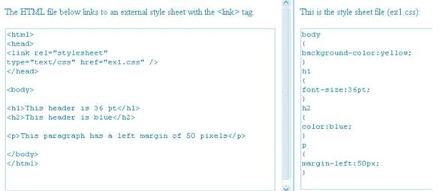
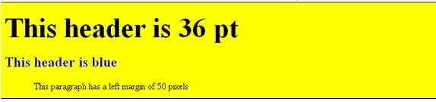

Slide 13
INTERNAL STYLE SHEET
• It should be used when a Single Document has a unique
style.
• You can define internal styles in the head section of an
HTML page, by using the
• Eg:
<head>
<style type="text/css">
hr {color: sienna;}
p {margin-left:20px;}
<style>
tag,
like
this:
body {background-image:
</style>
</head>
url("images/back40.gif");}

Slide 14
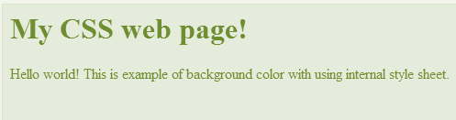
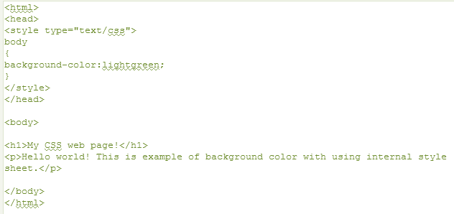

Slide 15
INLINE STYLE SHEET
Apply a unique style for a single element.
To use inline styles, add the style attribute to the relevant tag.
• The style attribute can contain any CSS property.
• E.g.
<h1 style="color:blue;margin-left:30px;">This is a heading.</h1>

Slide 16
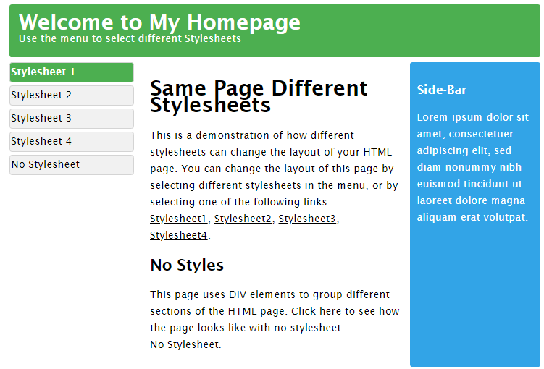

Slide 17
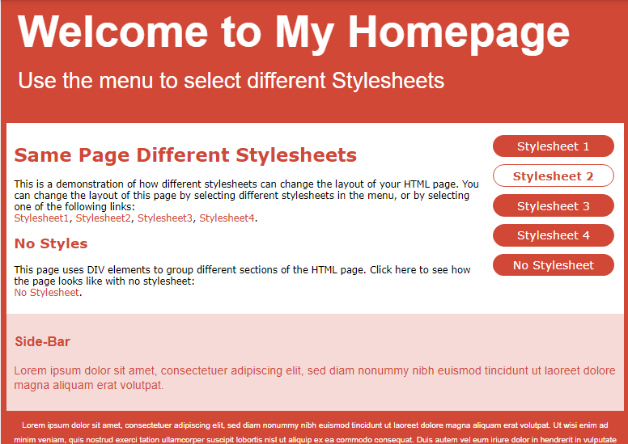

Slide 18
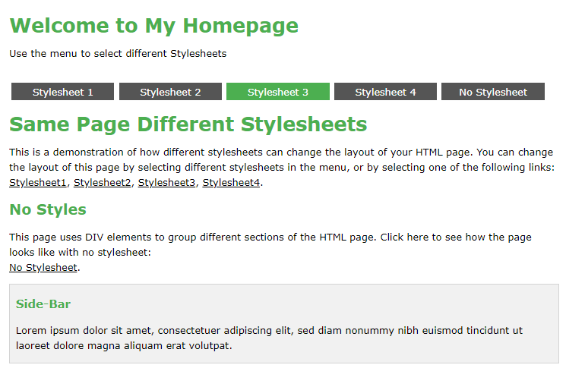

Slide 19
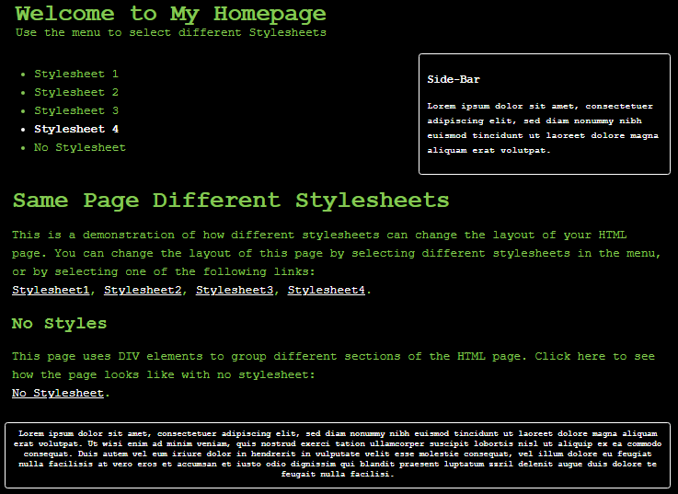

Slide 20
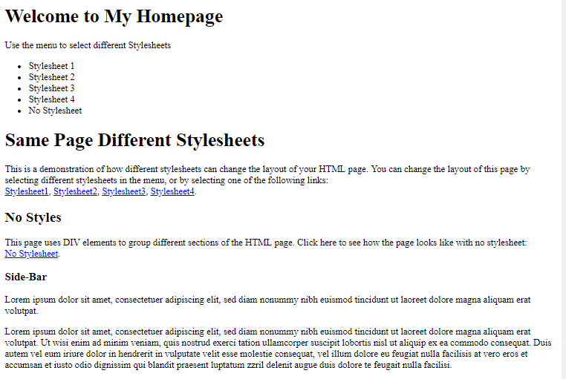

Slide 21
CSS STYLING
Background Color
Specifies the background color of an element.
Defined in the body selector.
Example
body {background-color:#b0c4de;}
The background color can be specified by:
name - a color name, like "red"
RGB - an RGB value, like "rgb(255,0,0)"
Hex - a hex value, like "#ff0000"
h1 {background-color:#6495ed;}

Slide 22
Background Image
Specifies an image to use as the background of an element.
Example
body
{background-image:url('paper.gif');}
By default, the background-image property repeats an image both horizontally and vertically.

Slide 23
Text Color
The color property is used to set the color of the text.
h1 {color:#00ff00;}
Text Alignment
Used to set the horizontal alignment of a text. Text can be centered, or aligned to the left or right, or justified.
h1 {text-align:center;}

Slide 24
Text Decoration
Set or remove decorations from text.
Mostly used to remove underlines from links for design purposes:
Example
a {text-decoration:none;}
h1 {text-decoration:overline;}
h4 {text-decoration:blink;}
Text Transformation
Specify uppercase and lowercase letters in a text.
Example
p.uppercase {text-transform:uppercase;} p.lowercase {text-transform:lowercase;} p.capitalize {text-transform:capitalize;}

Slide 25
Font Style
This property has three values:
normal - The text is shown normally
italic - The text is shown in italics
oblique - The text is "leaning" (oblique is very similar to italic, but less supported)
Example
p.normal {font-style:normal;}
Font Size
Sets the size of the text.

Slide 26
Styling Links
Links can be style with any CSS property (e.g. color, font-family, background-color). The four links states are:
a:link - a normal, unvisited link
a:visited - a link the user has visited
a:hover - a link when the user mouses over it
a:active - a link the moment it is clicked
Example
a:link {color:#FF0000;} /* unvisited link */ a:visited {color:#00FF00;} /* visited link */ a:hover {color:#FF00FF;} /* mouse over link */ a:active {color:#0000FF;} /* selected link */

Slide 27
CSS Tables
The look of an HTML table can be greatly improved with CSS
Table Borders
Use the border property.
The example below specifies a black border for table, th, and td elements:
Example
table, th, td
{
border: 1px solid black;
}
Other properties are:- Table Color, Table Padding, Border-Collapse, Alignment etc.

Slide 28
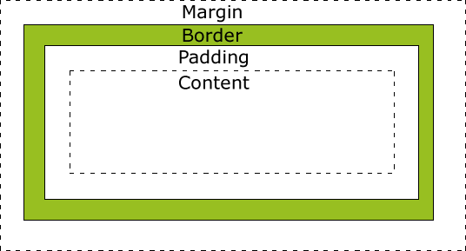
CSS BOX MODEL
All HTML elements can be considered as boxes. In CSS, the term "box model" is used when talking about design and layout.
A box that wraps around HTML elements.
Allows us to place a border around elements and space elements in relation to other elements.
The image below illustrates the box model:

Slide 29
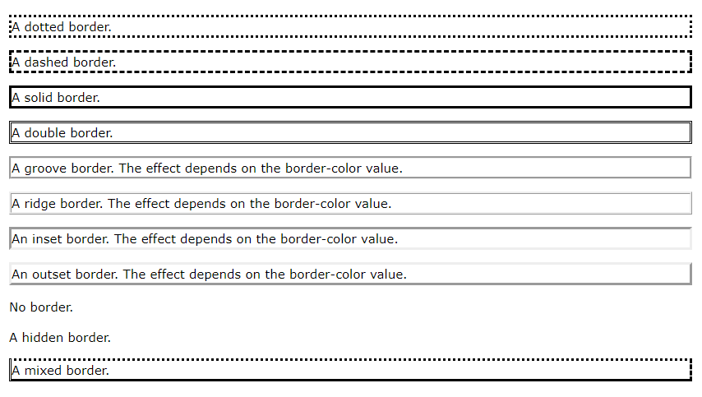
CSS BORDER
Border Style
p.dotted {border-style: dotted;} p.dashed {border-style: dashed;} p.solid {border-style: solid;} p.double {border-style: double;} p.groove {border-style: groove;} p.ridge {border-style: ridge;}
Border Width
Border Color

Slide 30
Other CSS properties
CSS Lists
CSS Outline
CSS Text
CSS Icons
CSS Display
CSS Max-width
CSS Position
CSS Overflow
CSS Combinators
CSS Pseudo-class
CSS Align
CSS Pseudo-element
CSS Opacity
CSS Navigation Bar
CSS Dropdowns
CSS Image Gallery
CSS Image Sprites
CSS Attr Selectors
CSS Forms
CSS Counters
CSS Website Layout
CSS Units
CSS Specificity
CSS Float
CSS Inline-block

Slide 31
CSS ADVANCED COMMANDS
CSS Rounded Corners
CSS Border Images
CSS Backgrounds
CSS Colors
CSS Gradients
CSS Shadows
CSS Text Effects
CSS Web Fonts
CSS 2D Transforms
CSS 3D Transforms
CSS Transitions
CSS Animations
CSS Tooltips
CSS Style Images
CSS object-fit
CSS Buttons
CSS Pagination
CSS Multiple Columns
CSS User Interface
CSS Variables
CSS Box Sizing
CSS Flexbox
CSS Media Queries

Slide 32
Media Queries Popular technique for delivering a tailored style sheet to desktops, laptops, tablets, and mobile phones.
CSS2 Introduced Media Types
@media rule define different style rules for different media types.
Examples: You could have one set of style rules for computer screens, one for printers, one for handheld devices, one for television-type devices, and so on.
Never got a lot of support by devices, other than the print media type.

Slide 33
CSS3 Introduced Media Queries
Extended the CSS2 media types idea.
Instead of looking for a type of device, they look at the capability of the device.
Media queries can be used to check many things, such as:
width and height of the viewport
width and height of the device
orientation (is the tablet/phone in landscape or portrait mode?)
resolution

Slide 34
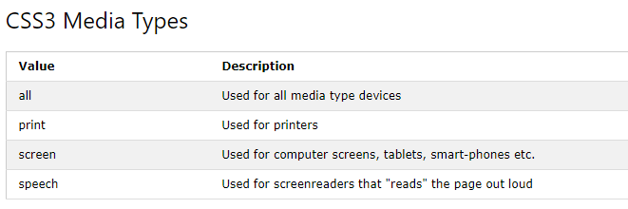
Syntax:-
@media not|only mediatype and (expressions) {
CSS-Code;
}

Slide 35
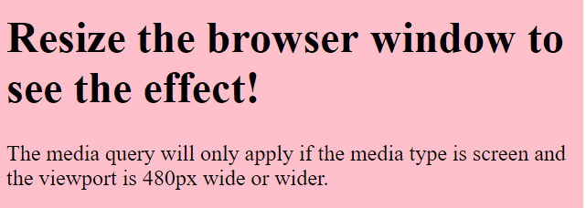
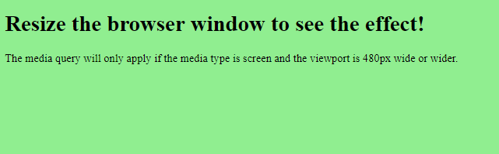
The following example changes the background-color to light-green if the viewport is 480 pixels wide or wider (if the viewport is less than 480 pixels, the background-color will be pink):
body {
background-color: pink;
}
@media screen and (min-width: 480px) {
body {
background-color: lightgreen;
}
}

Slide 36
THANK YOU

